Slide 1
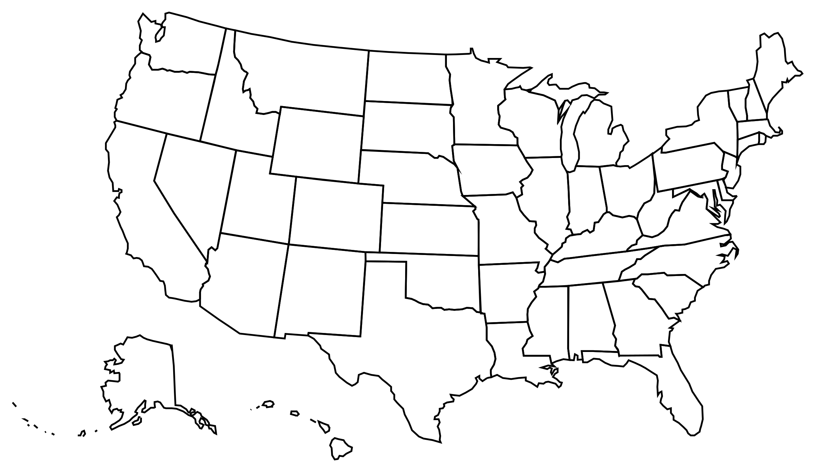
U.S. Energy Consumption and CO₂ Emissions
Energizers
Oswald Vinueza
Shahzad Naseer
Daniel Jones
July 29, 2019

Slide 2
OVERVIEW
PROBLEM
Energy consumption has grown
Environmental impacts have grown as well
OBJECTIVE
Gain a better understanding of the relationship between
energy consumption and
carbon dioxide (CO₂) emissions
from selected sectors of the United States (U.S.)
Industrial, Commercial. Transportation, Residential

Slide 3
MOTIVATION HYPOTHESIS
MOTIVATION
CO₂ emissions impact environment and health
Start discussion for solutions
HYPOTHESIS
Industrial and transportation sectors result in the highest energy consumption and emissions
Activities such as manufacturing require large amounts of energy to run

Slide 4
QUESTIONS
Which are the fastest growing sectors for energy consumption?
Industrial and Transportation
Which sectors produce the most emissions, and within each sector, which product group produces the most emissions?
Transportation and Industrial
Petroleum and motor gasoline
Which state produced the most emissions?
Texas
As total energy consumption increases, does CO₂ emissions increase?
Yes

Slide 5
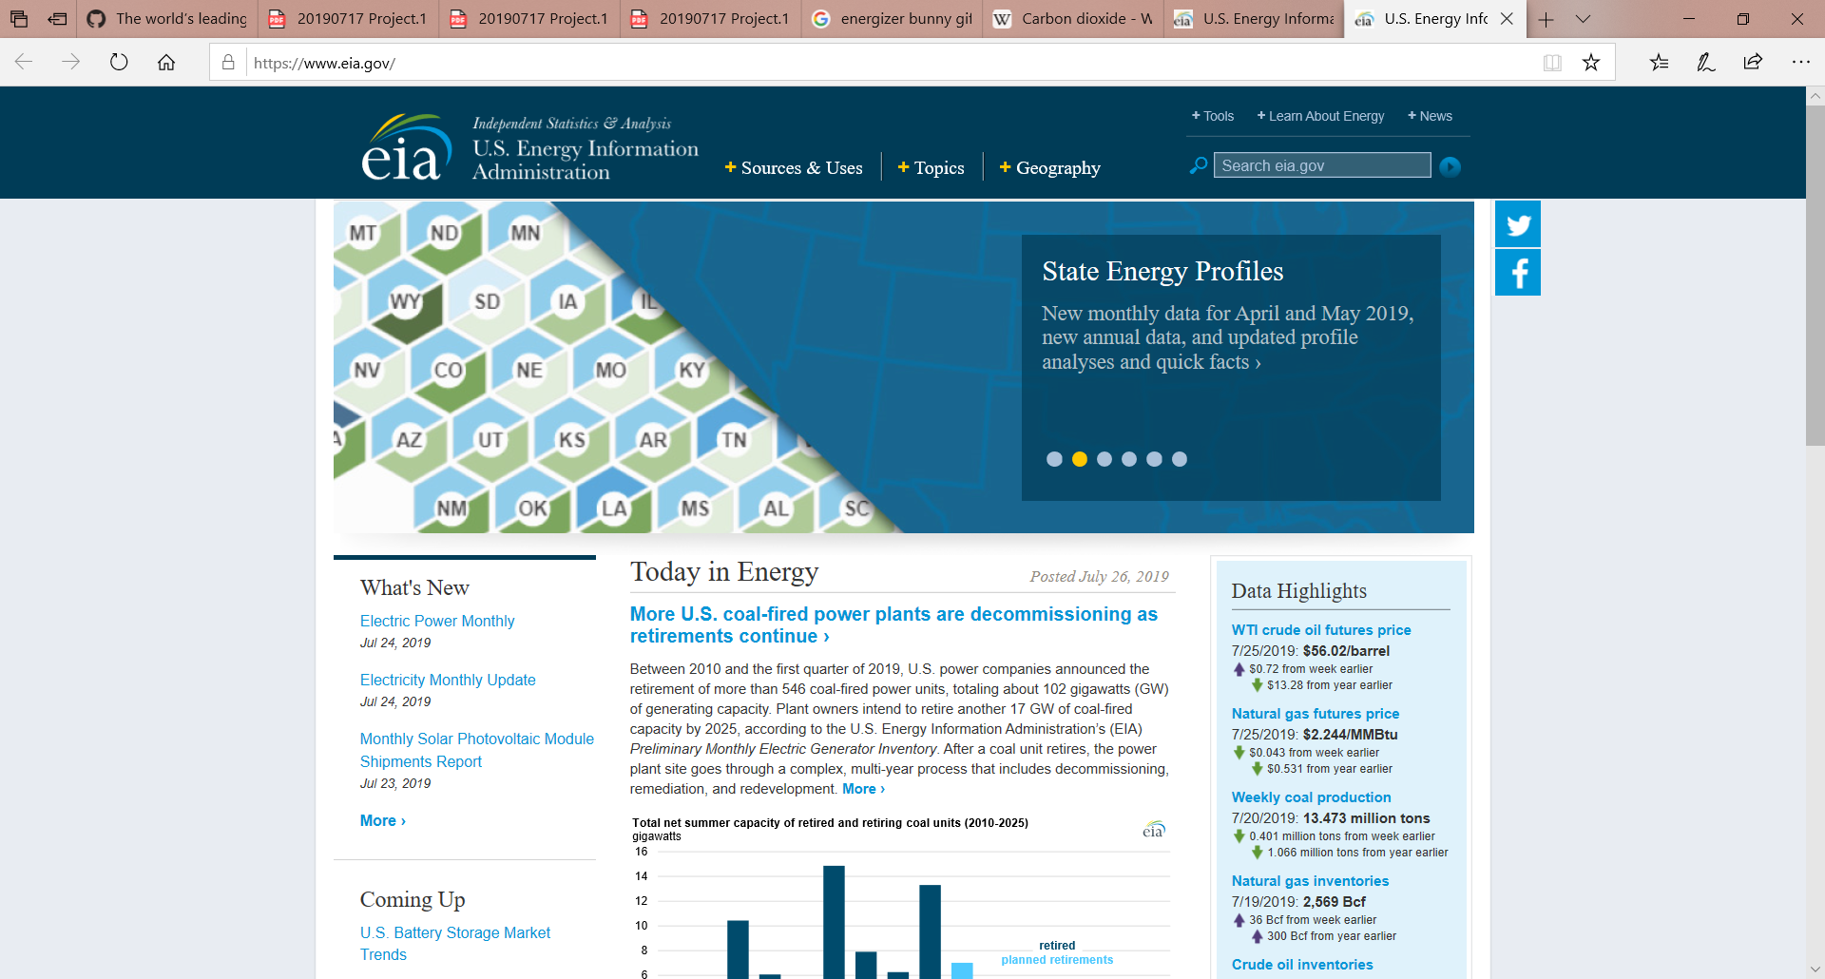
DATA
SOURCE
U.S. Energy Information Administration (EIA)
https://www.eia.gov/
DATA OVERVIEW: Energy consumption and emissions sectors
Industrial: facilities and equipment used for manufacturing, agriculture, mining and construction
Transportation: vehicles to transport people or goods such as cars, trucks, buses, motorcycles, trains, aircraft, boats, barges, and ships
Residential: homes and apartments
Commercial: offices, malls, stores, schools, hospitals, hotels, warehouses, restaurants and places of worship and public assembly
Electric power:
did not include in analysis
consumes primary energy to generate most of electricity the other four sectors consume
Time Frame: 2009 to 2018
technology has grown very rapidly
energy consumption and emissions by sector data are available through 2018
emissions by state data is only available through 2016

Slide 6
DATA EXPLORATION CLEANING and ANALYSIS
EXPLORATION AND CLEAN UP
All information available via API from the EIA
Not clear if Electric Power share for sectors was taken out on data (Double dip)
Missing 2 years of information for CO₂ state data
Dataset comprises of 11,359 observations and 13 characteristics
Data types except for value were object. Very few NANs
INSIGHTS
3 states produce the majority of CO₂
Industrial sector is 3 to 4 times larger than residential when looking at growth
Transportation produces more CO₂ than all sector combined

Slide 7
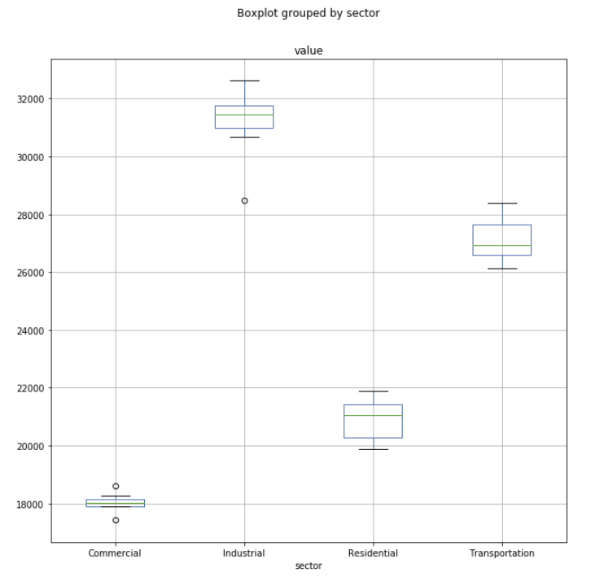
DATA EXPLORATION CLEANING and ANALYSIS
ANOVA TEST: Energy Consumption
Differences between the means are statistically significant
T-TEST: Energy Consumption
Differences between the means are statistically significant

Slide 8
DATA EXPLORATION CLEANING and ANALYSIS
ANOVA
pvalue | 1.023e-30
T-TESTS
PVALUES | Ind | Trans | Resi | Comm
Ind |  | 5.310e-08 | 8.039e-14 | 3.282e-12
Trans |  |  | 2.113e-13 | 1.064e-13
Resi |  |  |  | 7.285e-08
Comm

Slide 9
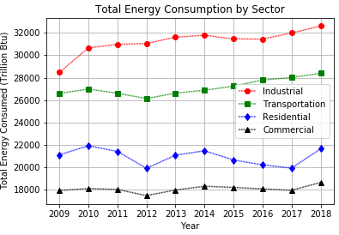
Which are the fastest growing sectors for energy consumption?

Slide 10
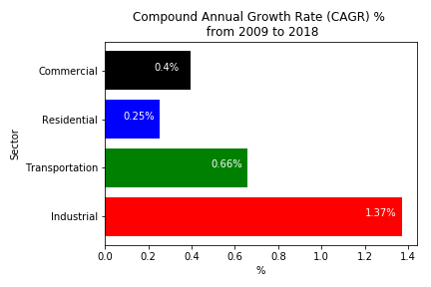
Which are the fastest growing sectors for energy consumption? Industrial Transportation

Slide 11
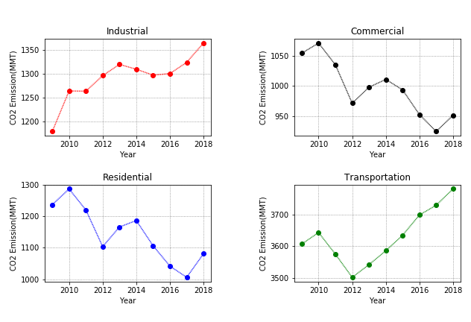
Which sectors produce the most emissions, and within each sector, which product group produces the most emissions?

Slide 12
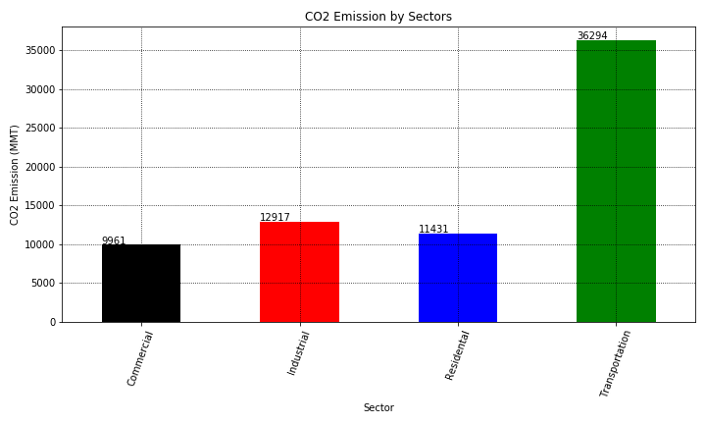
Which sectors produce the most emissions, and within each sector, which product group produces the most emissions? Industrial Transportation

Slide 13
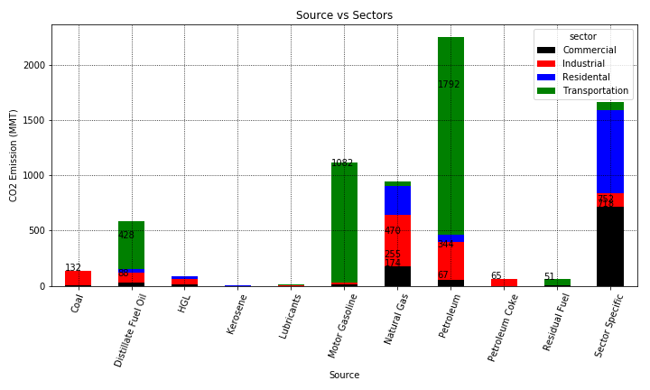
Which sectors produce the most emissions, and within each sector, which product group produces the most emissions? Petroleum Motor Gasoline

Slide 14
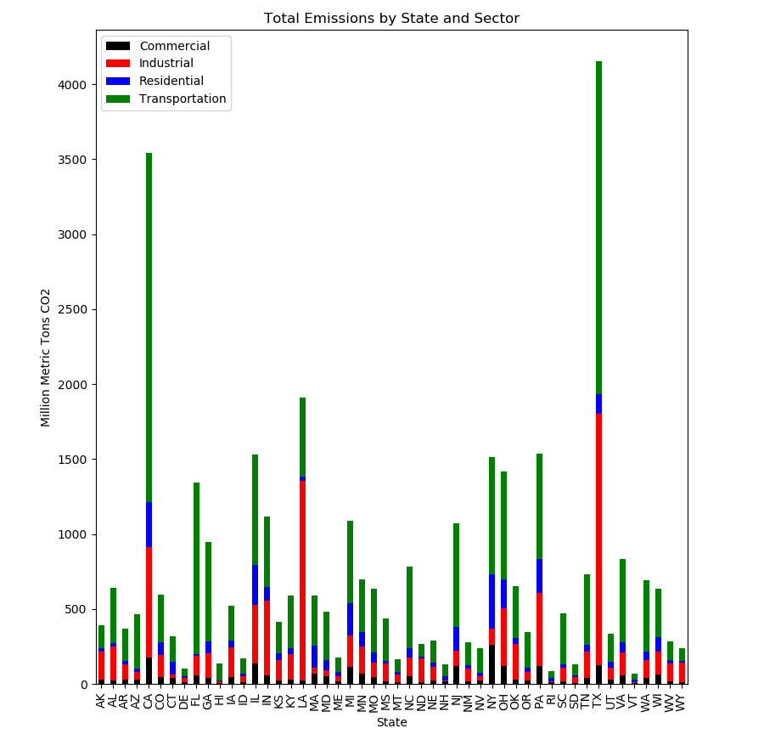
Which state produced the most emissions? Texas

Slide 15
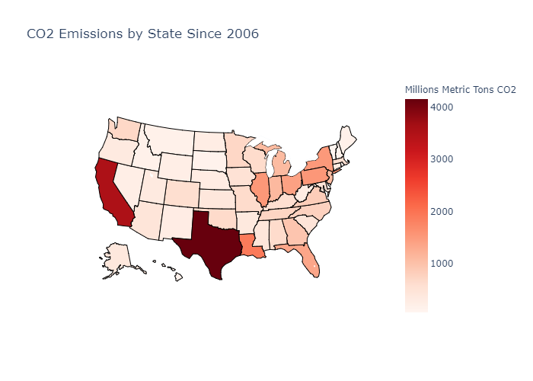
Which state produced the most emissions? Texas

Slide 16
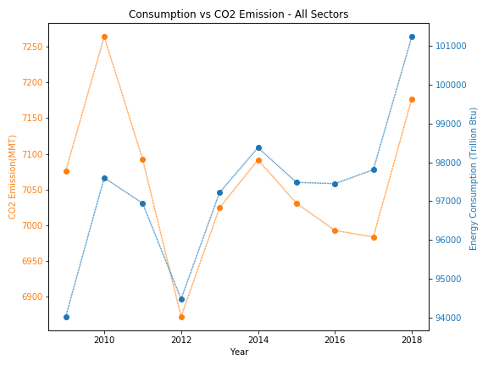
As total energy consumption increases, does CO₂ emissions increase? Yes

Slide 17
SUMMARY
RESULTS
As hypothesized, Transportation and Industrial sectors are largest energy consumers and producers of CO₂
As energy consumption increases, CO₂ emissions grow as well
CALL TO ACTION
New ways for power the Transportation and Industrial sectors are necessary

Slide 18
POST MORTEM
POST MORTEM
Challenges
EIA has several different views of emission and consumption data
Agreed on what to focus on
For CO₂ Emissions, sector specific product sources (Jet Fuel in Transportation)
Not a clear way to compare across sectors
Grouped into “Sector Specific”
Additional questions | research
What is the correlation, if any, between energy consumption and emissions between sectors?
What are the drivers for energy consumption increase?
What caused a decrease in consumption in 2012?

Slide 19

QUESTIONS
????

